Slide 1
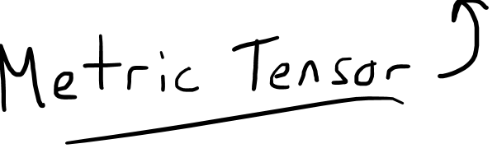
Bilinear Forms

Slide 2

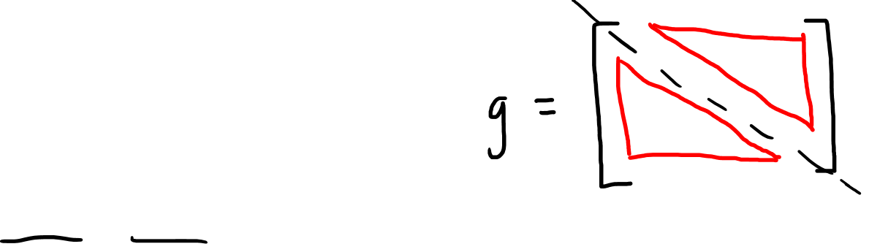
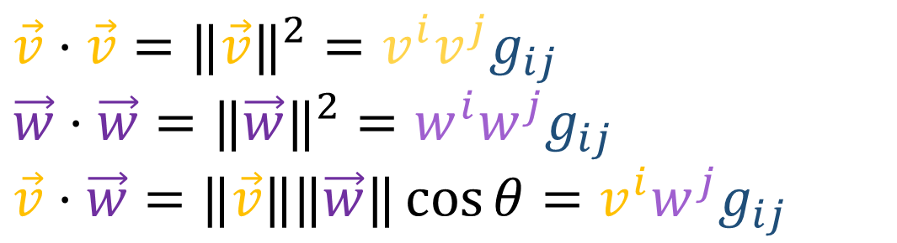
Metric Tensor Review
Components $g_{ij}=\vec{e_{i}}⋅\vec{e_{j}}$
$g_{ij}=\vec{e_{i}}⋅\vec{e_{j}}=\vec{e_{j}}⋅\vec{e_{i}}$ $=g_{ji}$
Use it to get lengths and angles
Metric tensor is a function $g:V×V→ℝ$
$g\left(\vec{v},\vec{w}\right)↦v^{i}w^{j}g_{ij}$
$$\vec{v}⋅\vec{v}={‖\vec{v}‖}^{2}=v^{i}v^{j}g_{ij}$$
$$\vec{w}⋅\vec{w}={‖\vec{w}‖}^{2}=w^{i}w^{j}g_{ij}$$
$$\vec{v}⋅\vec{w}=‖\vec{v}‖‖\vec{w}‖\cos{θ}=v^{i}w^{j}g_{ij}$$

Slide 3
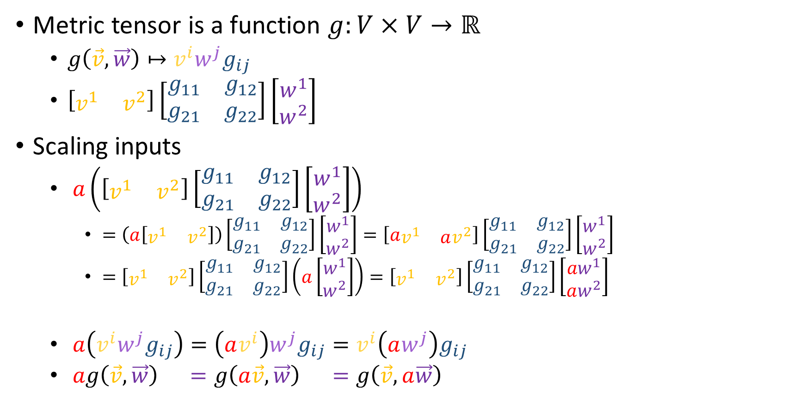
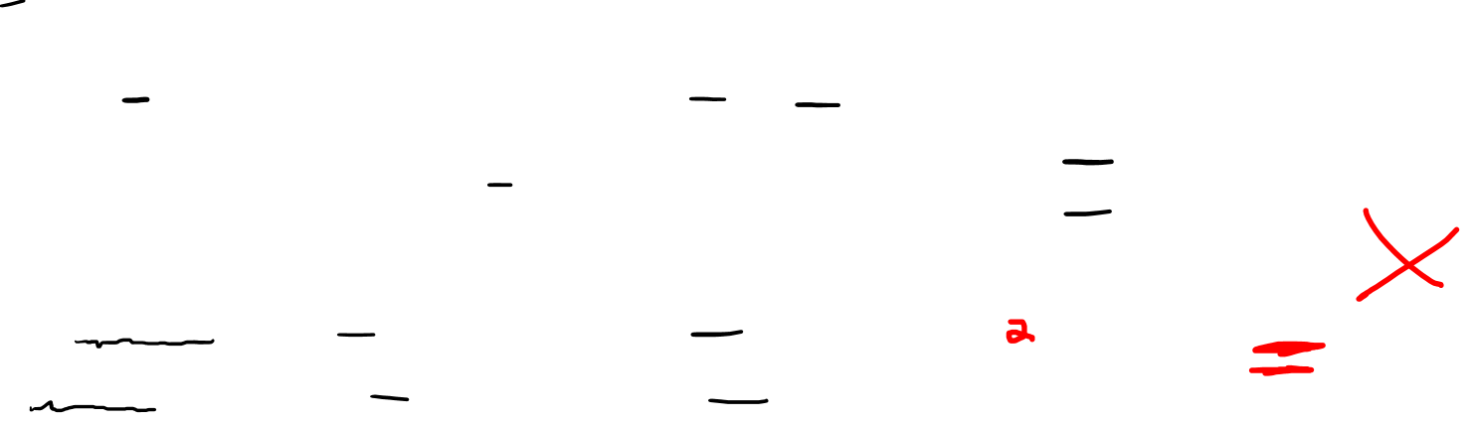

Metric Tensor Review
Metric tensor is a function $g:V×V→ℝ$
$g\left(\vec{v},\vec{w}\right)↦v^{i}w^{j}g_{ij}$
$\left[\begin{matrix}v^{1} & v^{2}\end{matrix}\right]\left[\begin{matrix}g_{11} & g_{12} \\ g_{21} & g_{22}\end{matrix}\right]\left[\begin{aligned}w^{1} \\ w^{2}\end{aligned}\right]$
Scaling inputs
$a\left(\left[\begin{matrix}v^{1} & v^{2}\end{matrix}\right]\left[\begin{matrix}g_{11} & g_{12} \\ g_{21} & g_{22}\end{matrix}\right]\left[\begin{aligned}w^{1} \\ w^{2}\end{aligned}\right]\right)$
$=\left(a\left[\begin{matrix}v^{1} & v^{2}\end{matrix}\right]\right)\left[\begin{matrix}g_{11} & g_{12} \\ g_{21} & g_{22}\end{matrix}\right]\left[\begin{aligned}w^{1} \\ w^{2}\end{aligned}\right]=\left[a\begin{matrix}v^{1} & av^{2}\end{matrix}\right]\left[\begin{matrix}g_{11} & g_{12} \\ g_{21} & g_{22}\end{matrix}\right]\left[\begin{aligned}w^{1} \\ w^{2}\end{aligned}\right]$
$=\left[\begin{matrix}v^{1} & v^{2}\end{matrix}\right]\left[\begin{matrix}g_{11} & g_{12} \\ g_{21} & g_{22}\end{matrix}\right]\left(a\left[\begin{aligned}w^{1} \\ w^{2}\end{aligned}\right]\right)=\left[\begin{matrix}v^{1} & v^{2}\end{matrix}\right]\left[\begin{matrix}g_{11} & g_{12} \\ g_{21} & g_{22}\end{matrix}\right]\left[\begin{aligned}{aw}^{1} \\ aw^{2}\end{aligned}\right]$
$a\left(v^{i}w^{j}g_{ij}\right)=\left(av^{i}\right)w^{j}g_{ij}=v^{i}\left(aw^{j}\right)g_{ij}$
$ag\left(\vec{v},\vec{w}\right) =g\left(a\vec{v},\vec{w}\right) =g\left(\vec{v},a\vec{w}\right)$
$$ag\left(\vec{v},\vec{w}\right)≠g\left(a\vec{v},a\vec{w}\right)$$

Slide 4

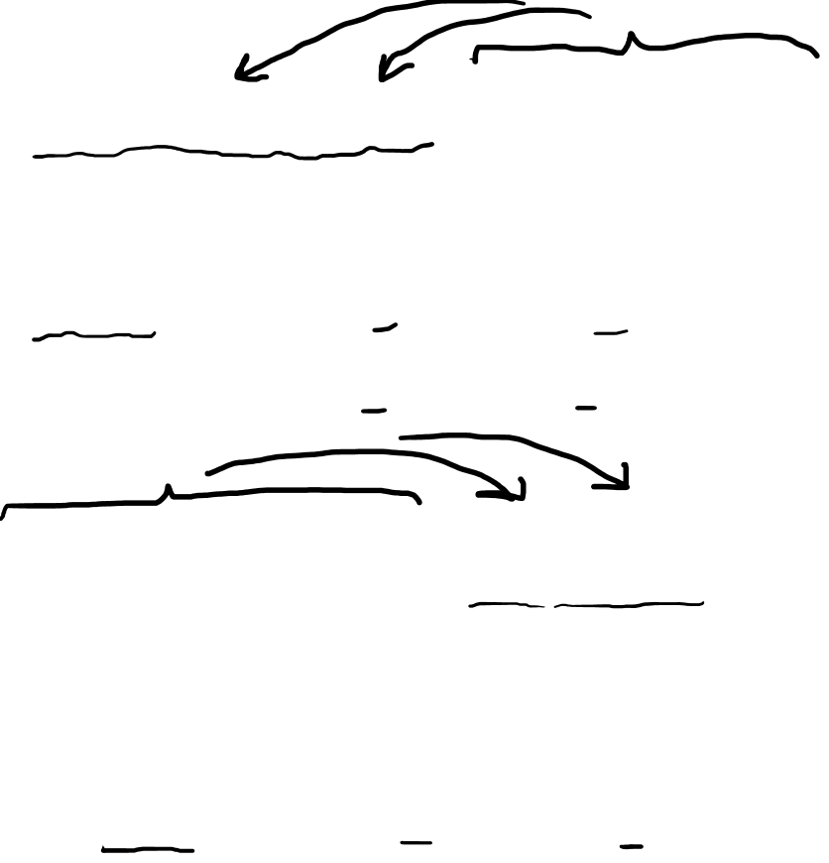
Metric Tensor Review
Adding inputs
$\left(\left[\begin{matrix}v^{1} & v^{2}\end{matrix}\right]+\left[\begin{matrix}u^{1} & u^{2}\end{matrix}\right]\right)\left[\begin{matrix}g_{11} & g_{12} \\ g_{21} & g_{22}\end{matrix}\right]\left[\begin{aligned}w^{1} \\ w^{2}\end{aligned}\right]$
$$=\left[\begin{matrix}v^{1} & v^{2}\end{matrix}\right]\left[\begin{matrix}g_{11} & g_{12} \\ g_{21} & g_{22}\end{matrix}\right]\left[\begin{aligned}w^{1} \\ w^{2}\end{aligned}\right]+\left[\begin{matrix}u^{1} & u^{2}\end{matrix}\right]\left[\begin{matrix}g_{11} & g_{12} \\ g_{21} & g_{22}\end{matrix}\right]\left[\begin{aligned}w^{1} \\ w^{2}\end{aligned}\right]$$
$\left(v^{i}+u^{i}\right)w^{j}g_{ij}=v^{i}w^{j}g_{ij}+u^{i}w^{j}g_{ij}$
$g\left(\vec{v}+\vec{u},\vec{w}\right)=g\left(\vec{v},\vec{w}\right)+g\left(\vec{u},\vec{w}\right)$
$\left[\begin{matrix}v^{1} & v^{2}\end{matrix}\right]\left[\begin{matrix}g_{11} & g_{12} \\ g_{21} & g_{22}\end{matrix}\right]\left(\left[\begin{aligned}w^{1} \\ w^{2}\end{aligned}\right]+\left[\begin{aligned}t^{1} \\ t^{2}\end{aligned}\right]\right)$
$$=\left[\begin{matrix}v^{1} & v^{2}\end{matrix}\right]\left[\begin{matrix}g_{11} & g_{12} \\ g_{21} & g_{22}\end{matrix}\right]\left[\begin{aligned}w^{1} \\ w^{2}\end{aligned}\right]+\left[\begin{matrix}v^{1} & v^{2}\end{matrix}\right]\left[\begin{matrix}g_{11} & g_{12} \\ g_{21} & g_{22}\end{matrix}\right]\left[\begin{aligned}t^{1} \\ t^{2}\end{aligned}\right]$$
$v^{i}\left(w^{j}+t^{j}\right)g_{ij}=v^{i}w^{j}g_{ij}+v^{i}t^{j}g_{ij}$
$g\left(\vec{v},\vec{w}+\vec{t}\right)=g\left(\vec{v},\vec{w}\right)+g\left(\vec{v},\vec{t}\right)$

Slide 5
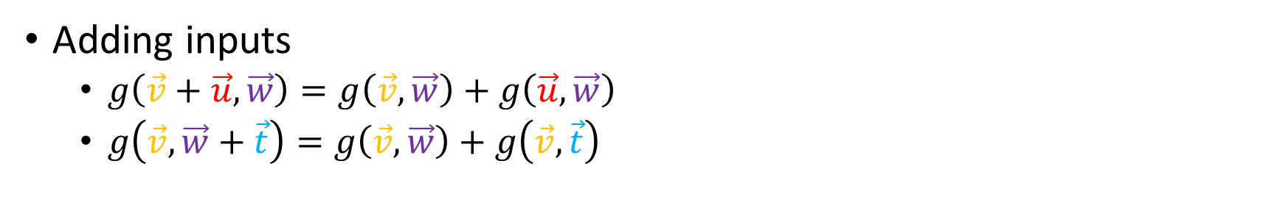
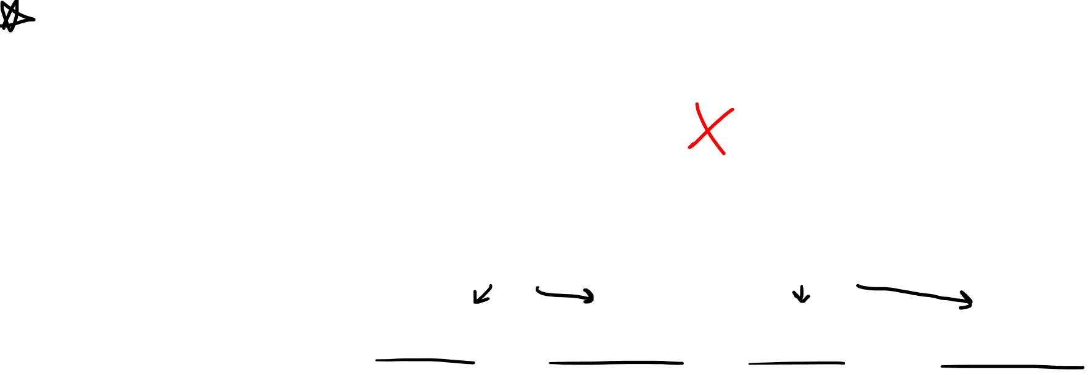
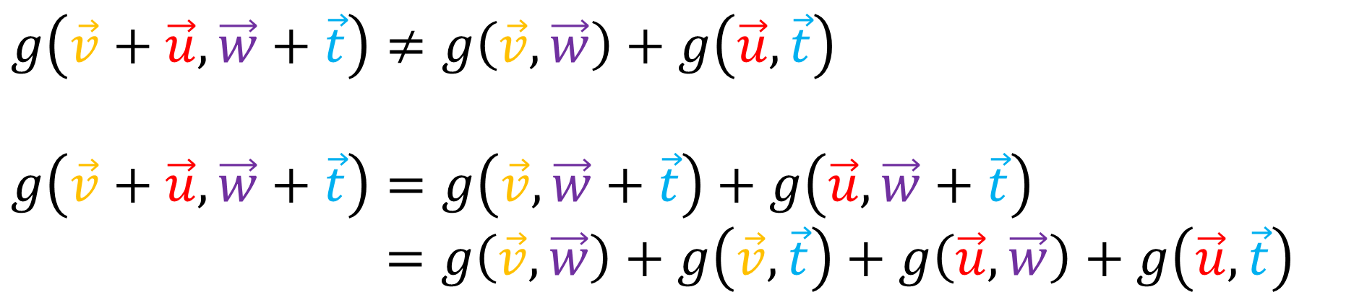
Metric Tensor Review
Adding inputs
$g\left(\vec{v}+\vec{u},\vec{w}\right)=g\left(\vec{v},\vec{w}\right)+g\left(\vec{u},\vec{w}\right)$
$g\left(\vec{v},\vec{w}+\vec{t}\right)=g\left(\vec{v},\vec{w}\right)+g\left(\vec{v},\vec{t}\right)$
$$g\left(\vec{v}+\vec{u},\vec{w}+\vec{t}\right)≠g\left(\vec{v},\vec{w}\right)+g\left(\vec{u},\vec{t}\right)$$
$$g\left(\vec{v}+\vec{u},\vec{w}+\vec{t}\right)=g\left(\vec{v},\vec{w}+\vec{t}\right)+g\left(\vec{u},\vec{w}+\vec{t}\right)$$
$=g\left(\vec{v},\vec{w}\right)+g\left(\vec{v},\vec{t}\right)+g\left(\vec{u},\vec{w}\right)+g\left(\vec{u}, \vec{t}\right)$

Slide 6
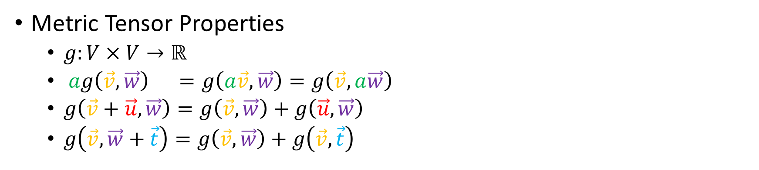



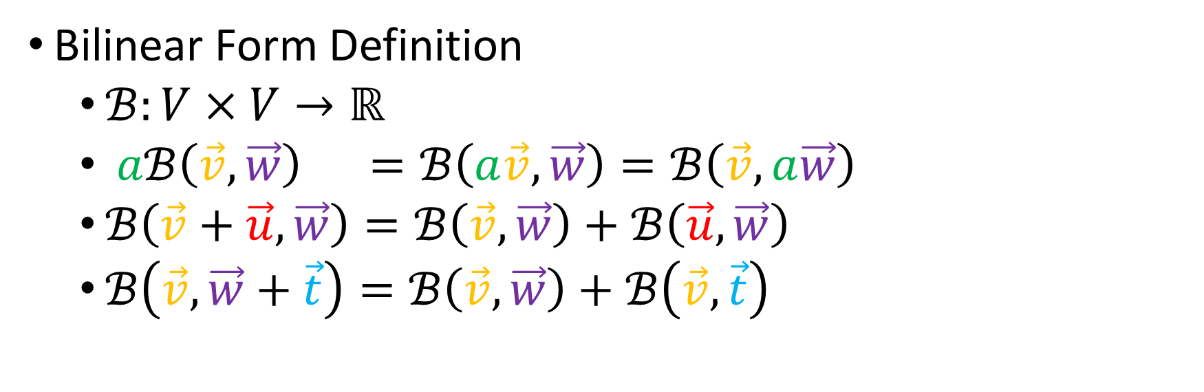
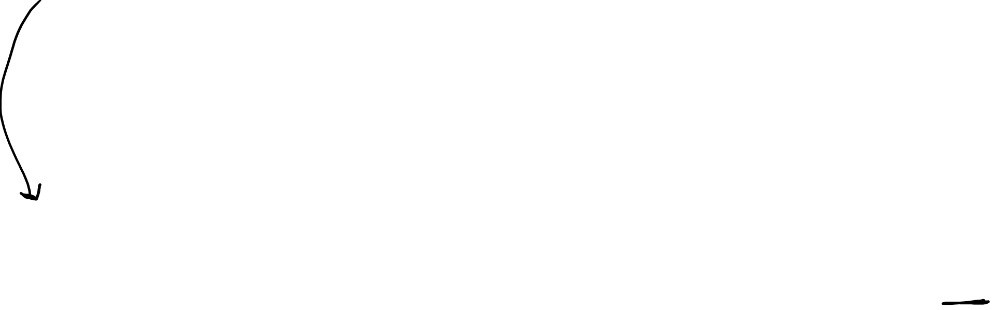
Metric Tensor Properties
$g:V×V→ℝ$
$ag\left(\vec{v},\vec{w}\right) =g\left(a\vec{v},\vec{w}\right)=g\left(\vec{v},a\vec{w}\right)$
$g\left(\vec{v}+\vec{u},\vec{w}\right)=g\left(\vec{v},\vec{w}\right)+g\left(\vec{u},\vec{w}\right)$
$g\left(\vec{v},\vec{w}+\vec{t}\right)=g\left(\vec{v},\vec{w}\right)+g\left(\vec{v},\vec{t}\right)$
$$g\left(\vec{v},\vec{w}\right)↦v^{i}w^{j}g_{ij}$$
(0,2)-Tensor
$$\tilde{ℬ_{ij}}=F_{i}^{k}F_{j}^{l}ℬ_{kl}$$
$$ℬ_{kl}=B_{k}^{i}B_{l}^{j}\tilde{ℬ_{ij}}$$
Bilinear Form Definition
$ℬ:V×V→ℝ$
$aℬ\left(\vec{v},\vec{w}\right) =ℬ\left(a\vec{v},\vec{w}\right)=ℬ\left(\vec{v},a\vec{w}\right)$
$ℬ\left(\vec{v}+\vec{u},\vec{w}\right)=ℬ\left(\vec{v},\vec{w}\right)+ℬ\left(\vec{u},\vec{w}\right)$
$ℬ\left(\vec{v},\vec{w}+\vec{t}\right)=ℬ\left(\vec{v},\vec{w}\right)+ℬ\left(\vec{v},\vec{t}\right)$
$$ℬ\left(\vec{v},\vec{w}\right)↦v^{i}w^{j}ℬ_{ij}$$

Slide 7
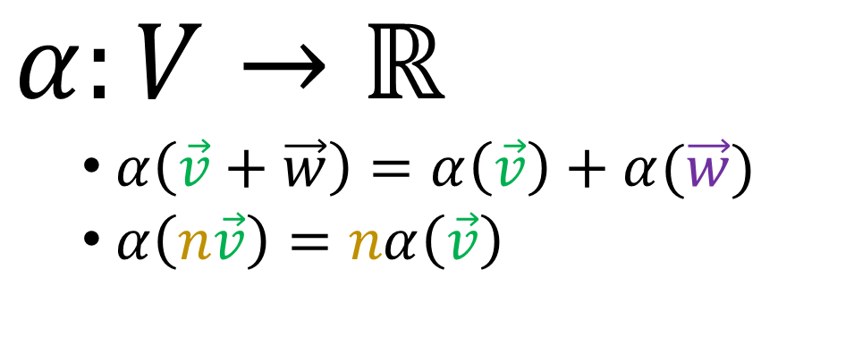


Forms $V×V×…×V→ℝ$
Covectors (Linear Forms)
aka 1-Forms
Bilinear Forms
$$α:V→ℝ$$
$α\left(\vec{v}+\vec{w}\right)=α\left(\vec{v}\right)+α(\vec{w})$
$α\left(n\vec{v}\right)=nα\left(\vec{v}\right)$
$$V×V→ℝ$$

Slide 8
Metric Tensor Properties
$g:V×V→ℝ$
$ag\left(\vec{v},\vec{w}\right) =g\left(a\vec{v},\vec{w}\right)=g\left(\vec{v},a\vec{w}\right)$
$g\left(\vec{v}+\vec{u},\vec{w}\right)=g\left(\vec{v},\vec{w}\right)+g\left(\vec{u},\vec{w}\right)$
$g\left(\vec{v},\vec{w}+\vec{t}\right)=g\left(\vec{v},\vec{w}\right)+g\left(\vec{v},\vec{t}\right)$
$$g\left(\vec{v},\vec{w}\right)↦v^{i}w^{j}g_{ij}$$
Bilinear Form Definition
$ℬ:V×V→ℝ$
$aℬ\left(\vec{v},\vec{w}\right) =ℬ\left(a\vec{v},\vec{w}\right)=ℬ\left(\vec{v},a\vec{w}\right)$
$ℬ\left(\vec{v}+\vec{u},\vec{w}\right)=ℬ\left(\vec{v},\vec{w}\right)+ℬ\left(\vec{u},\vec{w}\right)$
$ℬ\left(\vec{v},\vec{w}+\vec{t}\right)=ℬ\left(\vec{v},\vec{w}\right)+ℬ\left(\vec{v},\vec{t}\right)$
$$ℬ\left(\vec{v},\vec{w}\right)↦v^{i}w^{j}ℬ_{ij}$$

Slide 9


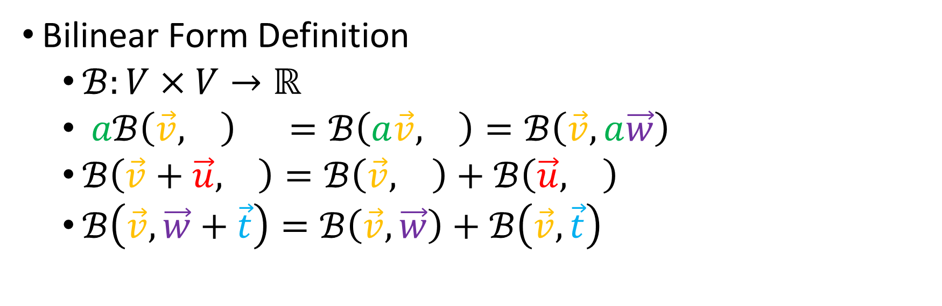
Metric Tensor Properties
$g:V×V→ℝ$
$ag\left(\vec{v},\vec{w}\right) =g\left(a\vec{v},\vec{w}\right)=g\left(\vec{v},a\vec{w}\right)$
$g\left(\vec{v}+\vec{u},\vec{w}\right)=g\left(\vec{v},\vec{w}\right)+g\left(\vec{u},\vec{w}\right)$
$g\left(\vec{v},\vec{w}+\vec{t}\right)=g\left(\vec{v},\vec{w}\right)+g\left(\vec{v},\vec{t}\right)$
$$g\left(\vec{v},\vec{w}\right)↦v^{i}w^{j}g_{ij}$$
Bilinear Form Definition
$ℬ:V×V→ℝ$
$aℬ\left(\vec{v},\vec{w}\right) =ℬ\left(a\vec{v},\vec{w}\right)=ℬ\left(\vec{v},a\vec{w}\right)$
$ℬ\left(\vec{v}+\vec{u},\vec{w}\right)=ℬ\left(\vec{v},\vec{w}\right)+ℬ\left(\vec{u},\vec{w}\right)$
$ℬ\left(\vec{v},\vec{w}+\vec{t}\right)=ℬ\left(\vec{v},\vec{w}\right)+ℬ\left(\vec{v},\vec{t}\right)$
$$ℬ\left(\vec{v},\vec{w}\right)↦v^{i}w^{j}ℬ_{ij}$$

Slide 10
Metric Tensor Properties
$g:V×V→ℝ$
$ag\left(\vec{v},\vec{w}\right) =g\left(a\vec{v},\vec{w}\right)=g\left(\vec{v},a\vec{w}\right)$
$g\left(\vec{v}+\vec{u},\vec{w}\right)=g\left(\vec{v},\vec{w}\right)+g\left(\vec{u},\vec{w}\right)$
$g\left(\vec{v},\vec{w}+\vec{t}\right)=g\left(\vec{v},\vec{w}\right)+g\left(\vec{v},\vec{t}\right)$
$$g\left(\vec{v},\vec{w}\right)↦v^{i}w^{j}g_{ij}$$
Bilinear Form Definition
$ℬ:V×V→ℝ$
$aℬ\left(\vec{v},\vec{w}\right) =ℬ\left(a\vec{v},\vec{w}\right)=ℬ\left(\vec{v},a\vec{w}\right)$
$ℬ\left(\vec{v}+\vec{u},\vec{w}\right)=ℬ\left(\vec{v},\vec{w}\right)+ℬ\left(\vec{u},\vec{w}\right)$
$ℬ\left(\vec{v},\vec{w}+\vec{t}\right)=ℬ\left(\vec{v},\vec{w}\right)+ℬ\left(\vec{v},\vec{t}\right)$
$$ℬ\left(\vec{v},\vec{w}\right)↦v^{i}w^{j}ℬ_{ij}$$

Slide 11
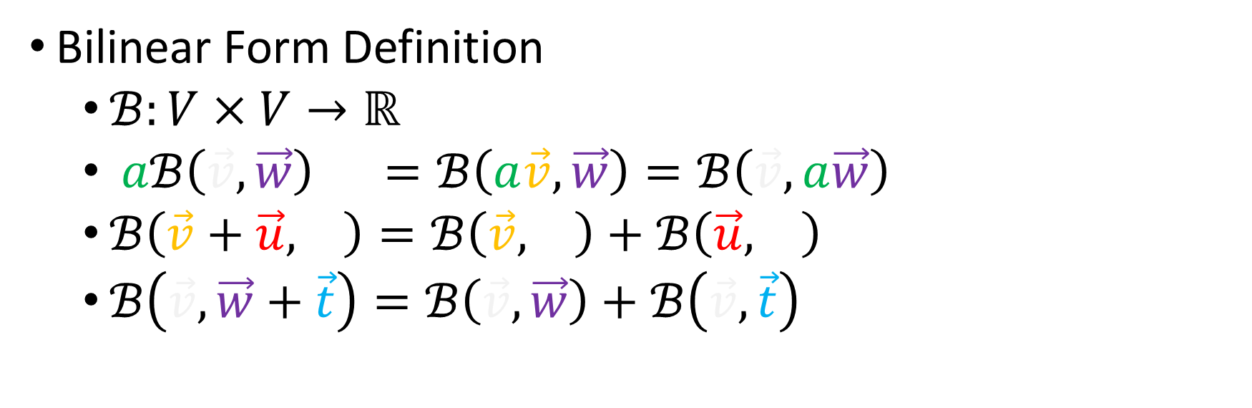
Metric Tensor Properties
$g:V×V→ℝ$
$ag\left(\vec{v},\vec{w}\right) =g\left(a\vec{v},\vec{w}\right)=g\left(\vec{v},a\vec{w}\right)$
$g\left(\vec{v}+\vec{u},\vec{w}\right)=g\left(\vec{v},\vec{w}\right)+g\left(\vec{u},\vec{w}\right)$
$g\left(\vec{v},\vec{w}+\vec{t}\right)=g\left(\vec{v},\vec{w}\right)+g\left(\vec{v},\vec{t}\right)$
$$g\left(\vec{v},\vec{w}\right)↦v^{i}w^{j}g_{ij}$$
Bilinear Form Definition
$ℬ:V×V→ℝ$
$aℬ\left(\vec{v},\vec{w}\right) =ℬ\left(a\vec{v},\vec{w}\right)=ℬ\left(\vec{v},a\vec{w}\right)$
$ℬ\left(\vec{v}+\vec{u},\vec{w}\right)=ℬ\left(\vec{v},\vec{w}\right)+ℬ\left(\vec{u},\vec{w}\right)$
$ℬ\left(\vec{v},\vec{w}+\vec{t}\right)=ℬ\left(\vec{v},\vec{w}\right)+ℬ\left(\vec{v},\vec{t}\right)$
$$ℬ\left(\vec{v},\vec{w}\right)↦v^{i}w^{j}ℬ_{ij}$$

Slide 12
Metric Tensor Properties
$g:V×V→ℝ$
$ag\left(\vec{v},\vec{w}\right) =g\left(a\vec{v},\vec{w}\right)=g\left(\vec{v},a\vec{w}\right)$
$g\left(\vec{v}+\vec{u},\vec{w}\right)=g\left(\vec{v},\vec{w}\right)+g\left(\vec{u},\vec{w}\right)$
$g\left(\vec{v},\vec{w}+\vec{t}\right)=g\left(\vec{v},\vec{w}\right)+g\left(\vec{v},\vec{t}\right)$
$$g\left(\vec{v},\vec{w}\right)↦v^{i}w^{j}g_{ij}$$
(0,2)-Tensor
$$\tilde{ℬ_{ij}}=F_{i}^{k}F_{j}^{l}ℬ_{kl}$$
$$ℬ_{kl}=B_{k}^{i}B_{l}^{j}\tilde{ℬ_{ij}}$$
Bilinear Form Definition
$ℬ:V×V→ℝ$
$aℬ\left(\vec{v},\vec{w}\right) =ℬ\left(a\vec{v},\vec{w}\right)=ℬ\left(\vec{v},a\vec{w}\right)$
$ℬ\left(\vec{v}+\vec{u},\vec{w}\right)=ℬ\left(\vec{v},\vec{w}\right)+ℬ\left(\vec{u},\vec{w}\right)$
$ℬ\left(\vec{v},\vec{w}+\vec{t}\right)=ℬ\left(\vec{v},\vec{w}\right)+ℬ\left(\vec{v},\vec{t}\right)$
$$ℬ\left(\vec{v},\vec{w}\right)↦v^{i}w^{j}ℬ_{ij}$$

Slide 13
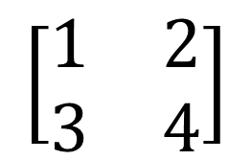
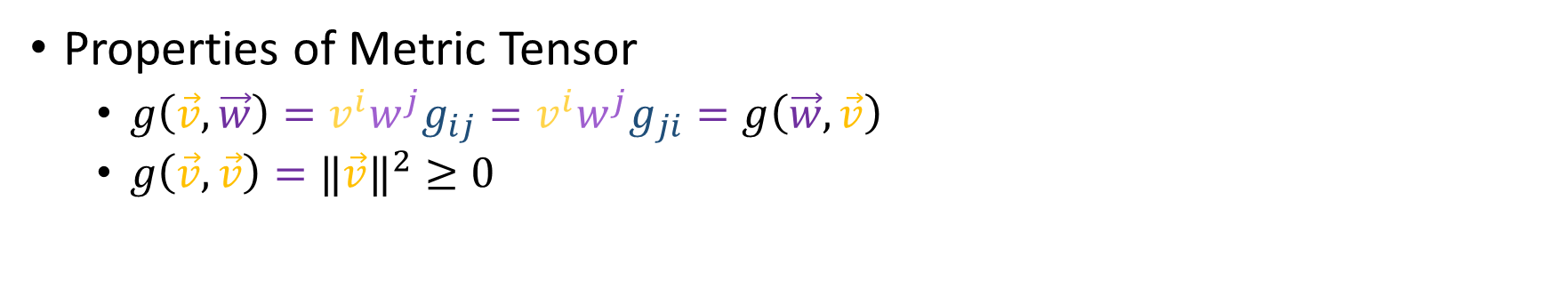
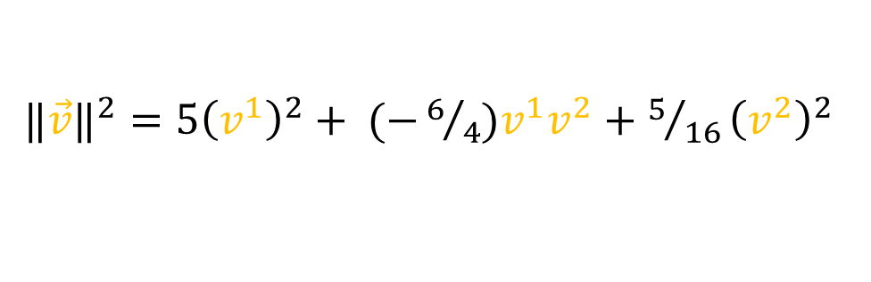
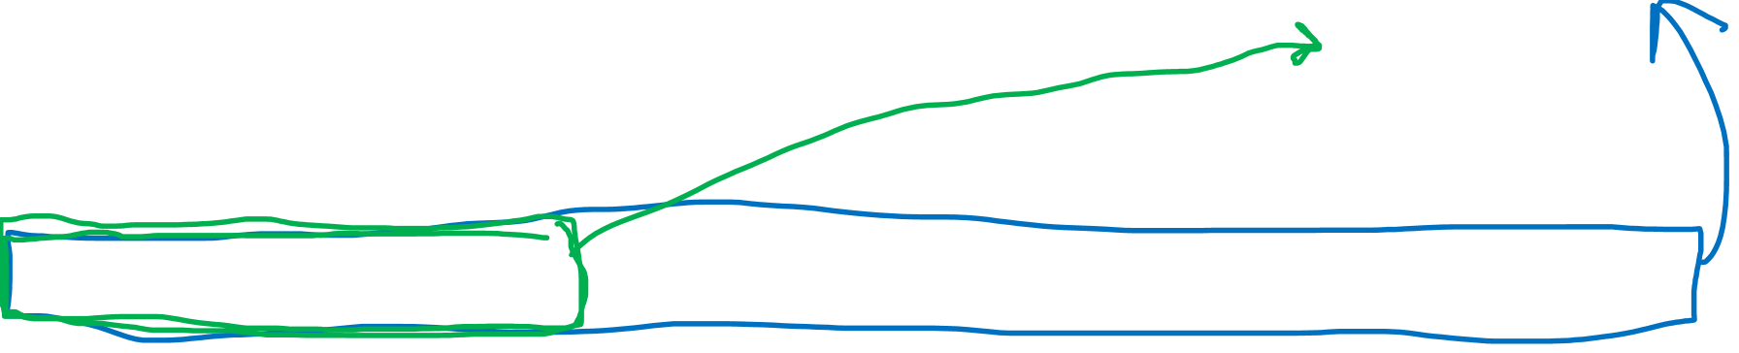

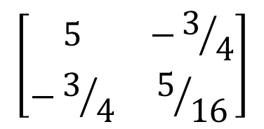
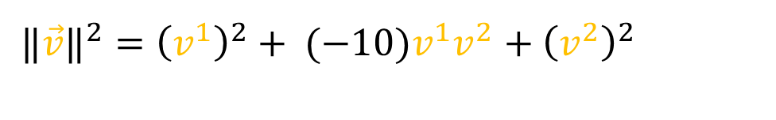
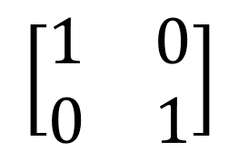
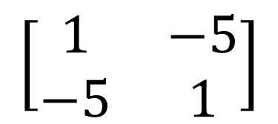
Bilinear Form vs Metric Tensor
Properties of Metric Tensor
$g\left(\vec{v},\vec{w}\right)=v^{i}w^{j}g_{ij}=v^{i}w^{j}g_{ji}=g\left(\vec{w},\vec{v}\right)$
$g\left(\vec{v},\vec{v}\right)={‖\vec{v}‖}^{2}≥0$
Valid Metric Tensors
Non-metric Bilinear Forms
$$\left[\begin{matrix}1 & 0 \\ 0 & 1\end{matrix}\right]$$
$$\left[\begin{matrix}1 & 2 \\ 3 & 4\end{matrix}\right]$$
$${‖\vec{v}‖}^{2}={ \left(v^{1}\right)}^{2}+ {\left(v^{2}\right)}^{2}$$
$$\left[\begin{matrix}5 & −3/4 \\ −3/4 & 5/{16}\end{matrix}\right]$$
$$\left[\begin{matrix}1 & −5 \\ −5 & 1\end{matrix}\right]$$
${‖\vec{v}‖}^{2}={5\left(v^{1}\right)}^{2}+ (−6/4)v^{1}v^{2}+{5/{16}\left(v^{2}\right)}^{2}$
${‖\vec{v}‖}^{2}={\left(v^{1}\right)}^{2}+ (−10)v^{1}v^{2}+{\left(v^{2}\right)}^{2}$

Slide 14


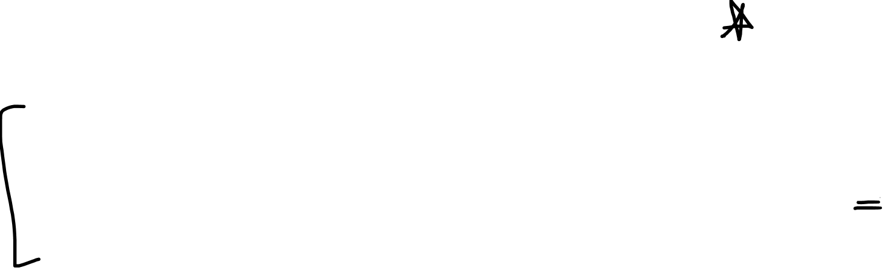

Bilinear Form Definition
$ℬ:V×V→ℝ$
$aℬ\left(\vec{v},\vec{w}\right) =ℬ\left(a\vec{v},\vec{w}\right)=ℬ\left(\vec{v},a\vec{w}\right)$
$ℬ\left(\vec{v}+\vec{u},\vec{w}\right)=ℬ\left(\vec{v},\vec{w}\right)+ℬ\left(\vec{u},\vec{w}\right)$
$ℬ\left(\vec{v},\vec{w}+\vec{t}\right)=ℬ\left(\vec{v},\vec{w}\right)+ℬ\left(\vec{v},\vec{t}\right)$
$$ℬ\left(\vec{v},\vec{w}\right)↦v^{i}w^{j}ℬ_{ij}$$
(0,2)-Tensor
$$\tilde{ℬ_{ij}}=F_{i}^{k}F_{j}^{l}ℬ_{kl}$$
$$ℬ_{kl}=B_{k}^{i}B_{l}^{j}\tilde{ℬ_{ij}}$$

